Slide 1
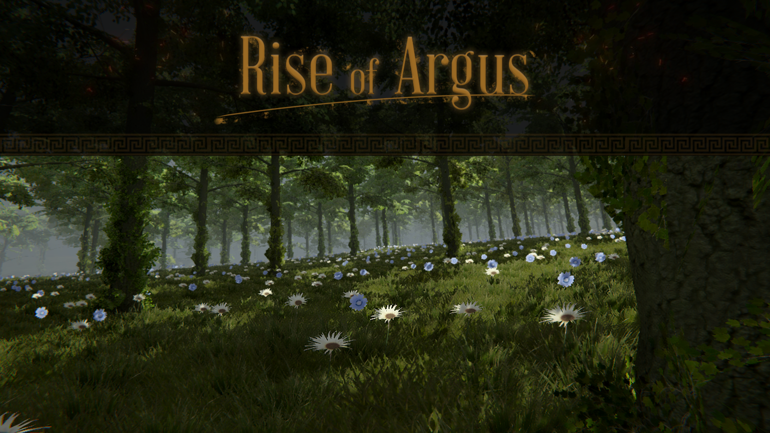

Slide 2

Inhoud
Gamemechanics
Assets
Map
Prototype

Slide 3
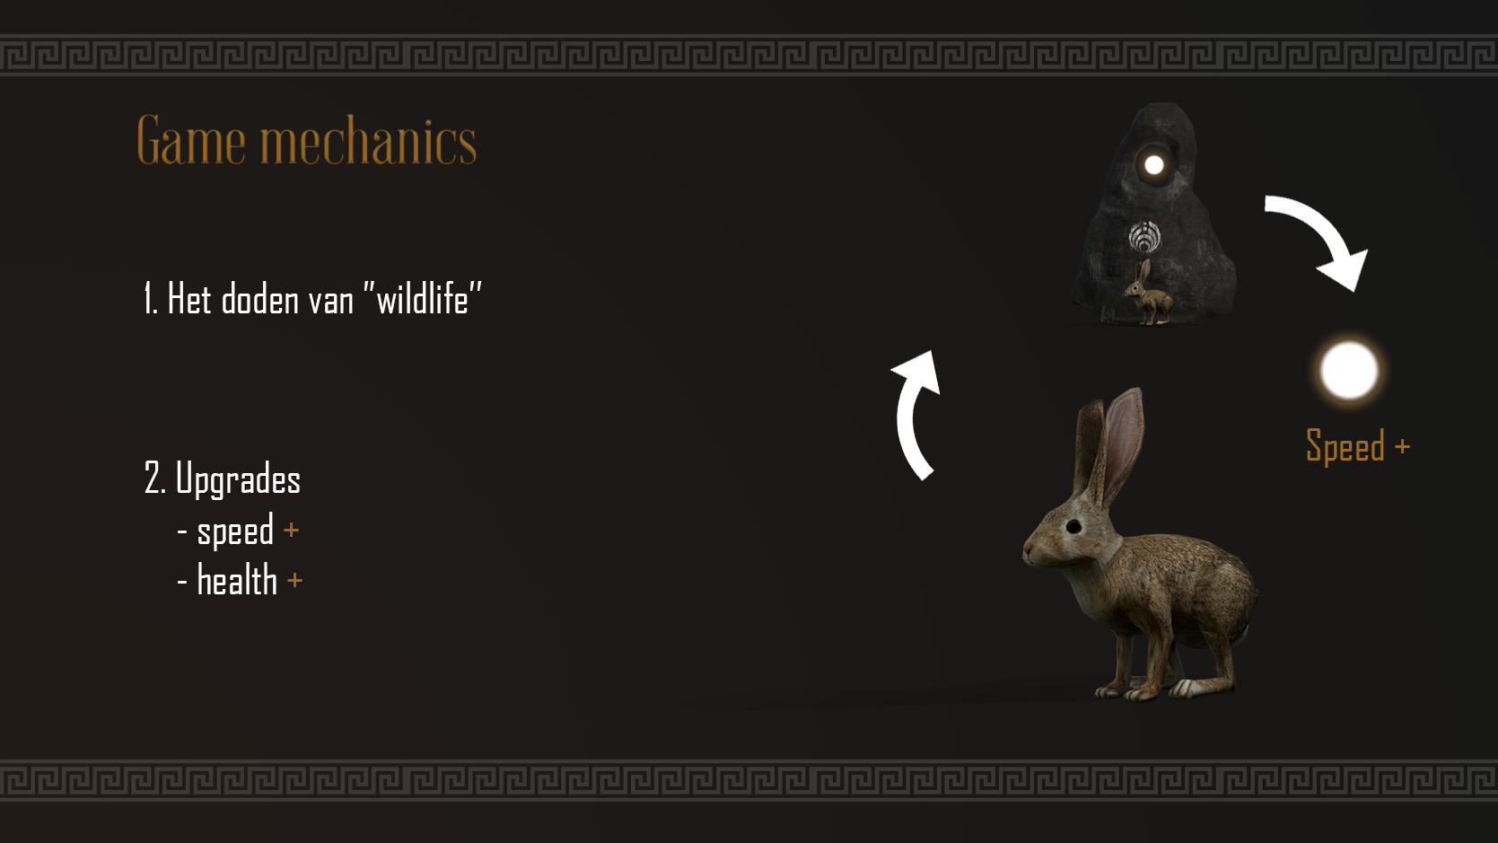

Slide 4
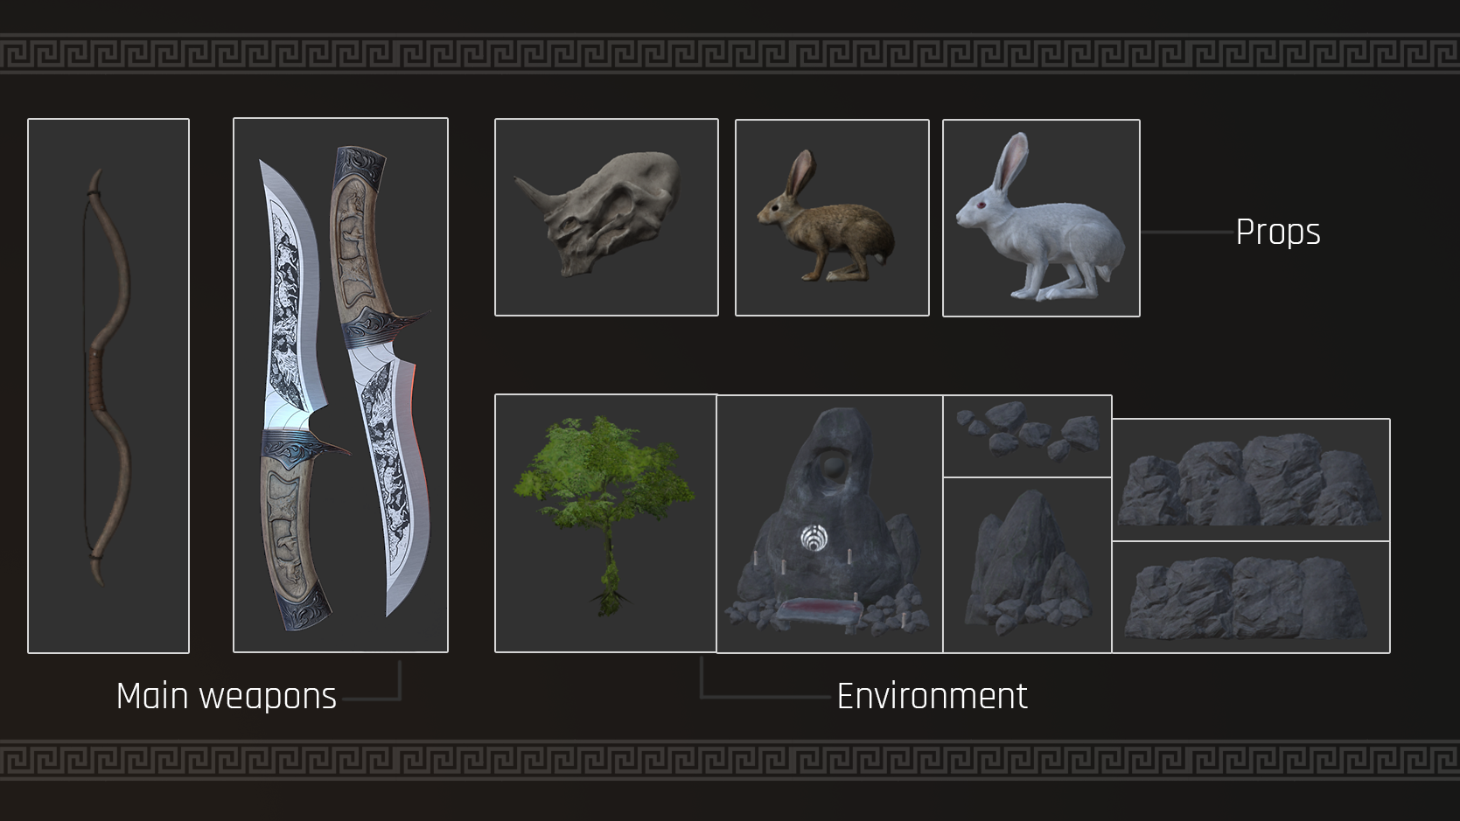

Slide 5
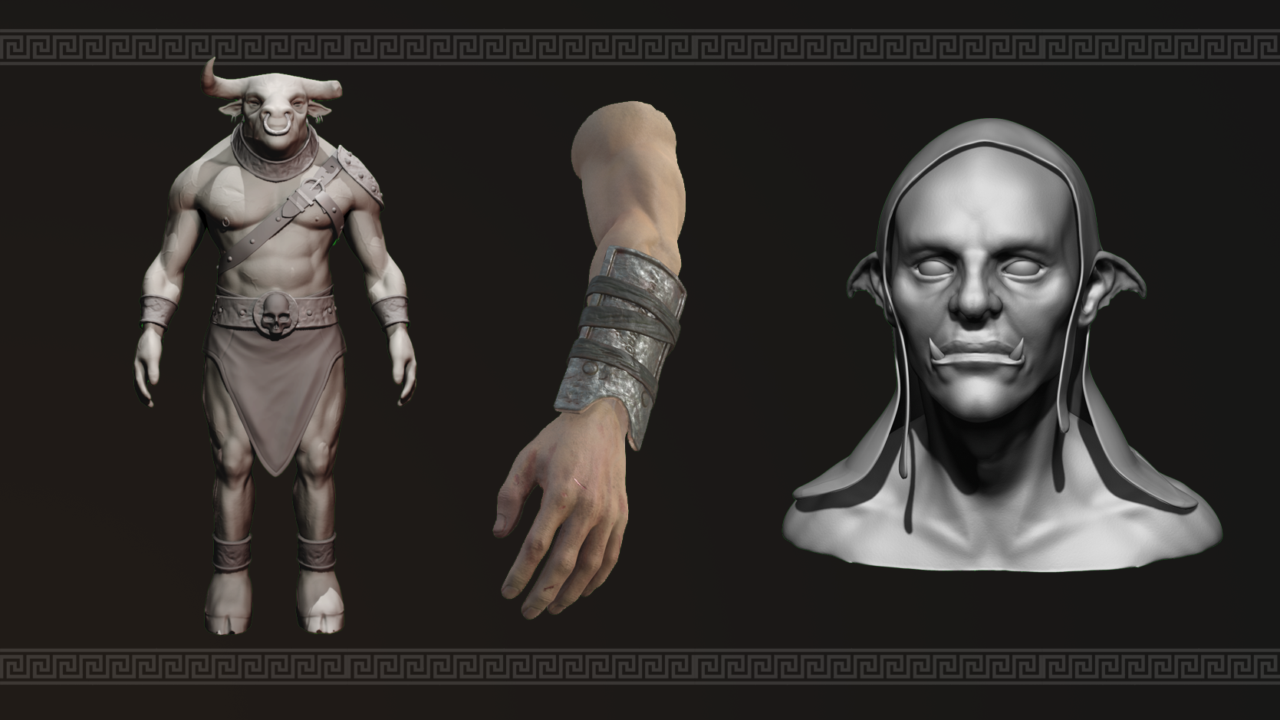

Slide 6
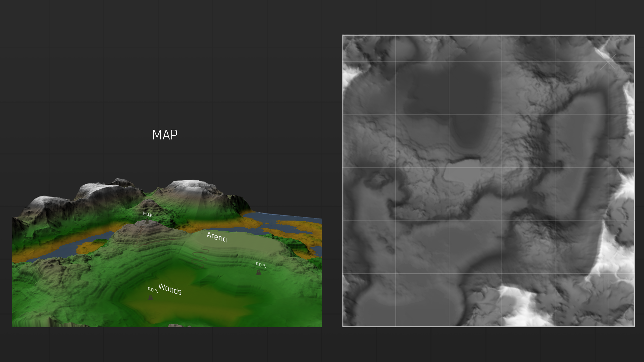

Slide 7
PROTOTYPE

